Slide 1
Energy Consumption Analysis for Buildings in San Francisco
Zohair Zulfiqar, Devanshi Mathur, Tekabe Fanta, Joy Mickle, Andrew Brannon, and Sehajmeet Sohal

Slide 2

Background
The Existing Buildings Energy Performance Ordinance in the City of San Francisco requires commercial and non-residential buildings that meet certain square footage requirements to report energy use and greenhouse gas emission data to the City.

Slide 3
Project Overview
GOAL
GOAL: Our goal was to identify energy usage and greenhouse gas emission trends, patterns, and relationships for commercial and residential buildings in San Francisco
ACTION
ACTION ITEMS: Using the insights from the data, we can advise and modify policies for reducing energy use and greenhouse gas emissions
RESOURCE
RESOURCE: Open Source Data from the City of San Francisco through the Existing Buildings Energy Performance Ordinance Report

Slide 4
Dataset and Cleaning
Data Fields Used
Data Cleaning
Building Name
Floor Area
Property Type
Property Subcategory
Source Energy Use Intensity (EUI) from years 2018-2022 (kBtu/sq-ft)
Total Greenhouse Gas Emissions (GHG) from years 2018-2022 (kGCO2e/sq-ft)
Renamed column headings in dataframe for easy extraction
Dropped rows with “Not Available” or “NaN” values

Slide 5
Question #1
What property subcategory type has the highest source EUI and GHG emissions per square footage in the year 2022? Is there a correlation between GHG emissions and source EUI?

Slide 6
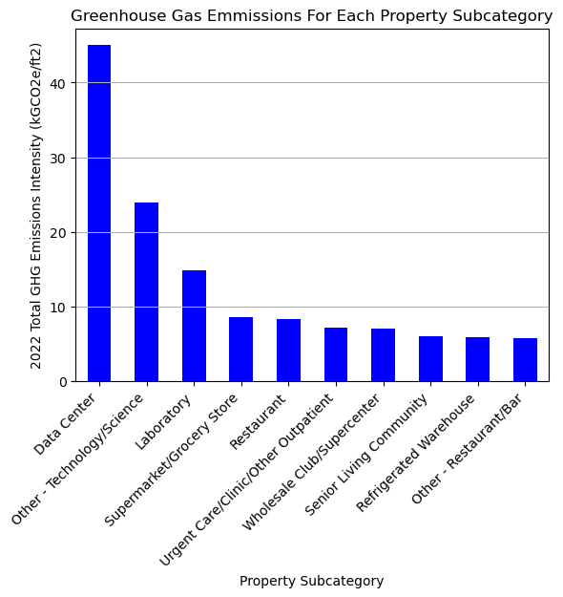
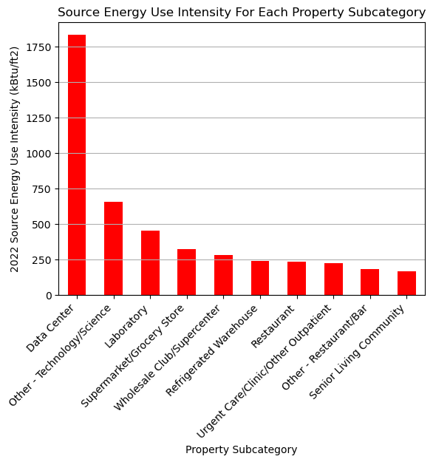
GHG Emissions
Source EUI
PROCEDURE: Used groupby function in pandas to create bar chart broken down by property subcategory
FINDINGS: Highest Source EUI and GHG Emitters are buildings that are continuously in use in the tech industry.

Slide 7
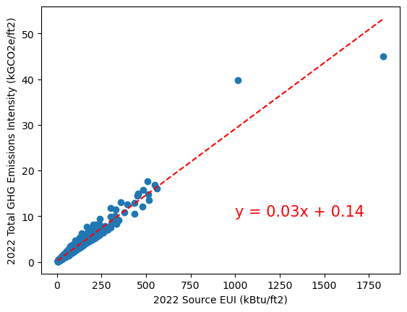
Correlation between GHG and Source EUI
The r-value is 0.948
PROCEDURE: Used linregress function in pandas to obtain parameters for a regression analysis
FINDINGS: Strong correlation between Source EUI and GHG Emissions. The more energy you use, the more emissions you have.

Slide 8
Question #2
For commercial and residential buildings, is there is a relationship between year built and greenhouse gas emission intensity?

Slide 9
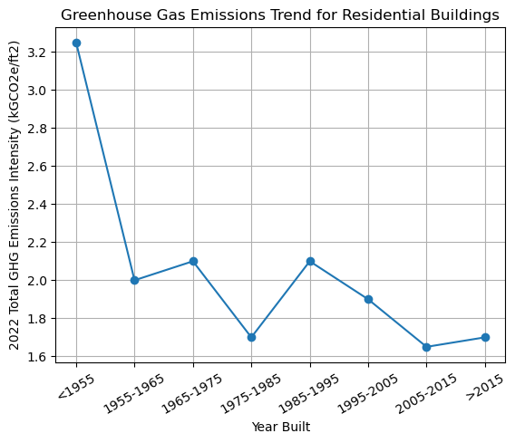
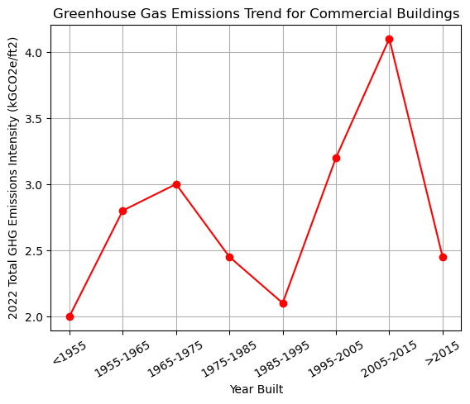
Residential Buildings
Commercial Buildings
PROCEDURE: Created bins and used the groupby function to plot the 2022 GHG emissions based on the year the building was built.
FINDINGS: Newer residential buildings are emitting less GHG. There was an uptick for GHG emissions for commercial buildings built in the new millennia – this is due to high emitting property types such as

Slide 10
Question #3
Has the greenhouse gas emission intensity for commercial and residential buildings decreased since 2018? Create boxplots for the 2022 GHG Emissions to calculate the quartiles and IQR and list the potential outlying properties for commercial and residential buildings.

Slide 11
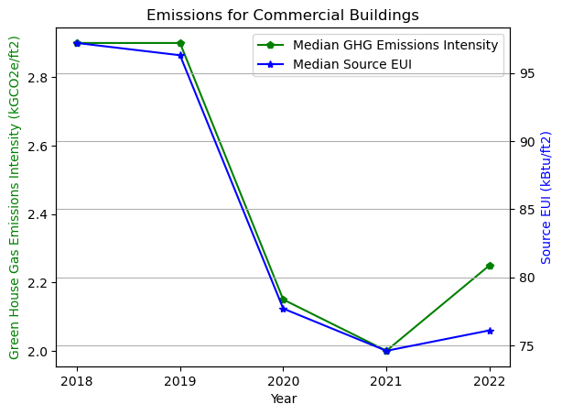
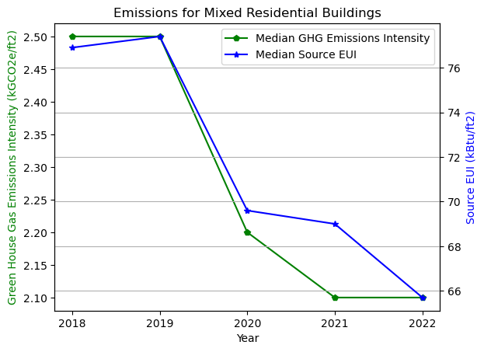
Commercial Buildings
Residential Buildings
PROCEDURE: Used median for statistical analysis of GHG emissions and EUI since there are potential outliers in the data.
FINDINGS: The GHG emissions and EUI consumption has reduced after 2018 as expected since the ordinance went in place.

Slide 12
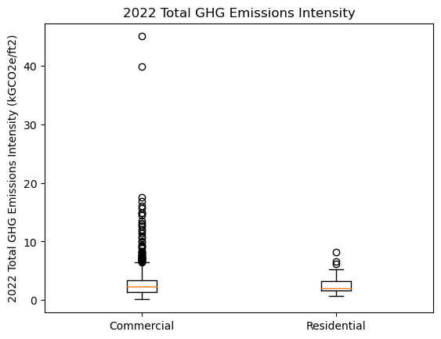
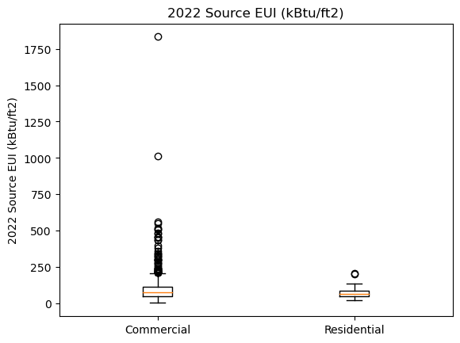
GHG Emissions boxplots
Source EUI boxplots
FINDINGS and CONCLUSION:
The Boxplot and IQR analysis for year 2022 shows that:
33.33% of commercial properties are outliers for GHG emission and 31.25% of commercial properties are outliers for Energy consumption with Data Center being the top for both.
14.29% of residential properties are outliers for GHG emission and 14.29% of residential properties are outliers for Energy consumption with Multifamily Housing being the top for both.
This analysis solidfies the correlation between energy consumption and greenhouse gases emission, the properties with highest energy consumption seems to have the highest GHG emission as well

Slide 13
Question #4
Is there a correlation between energy use and building floor area?

Slide 14
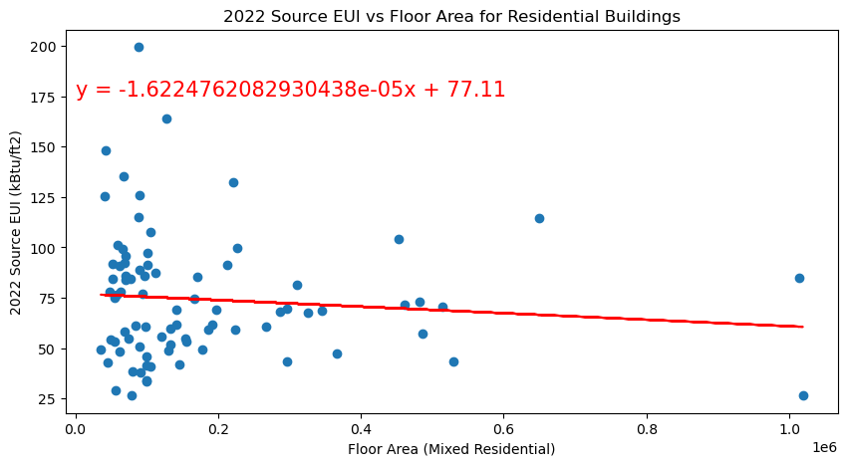
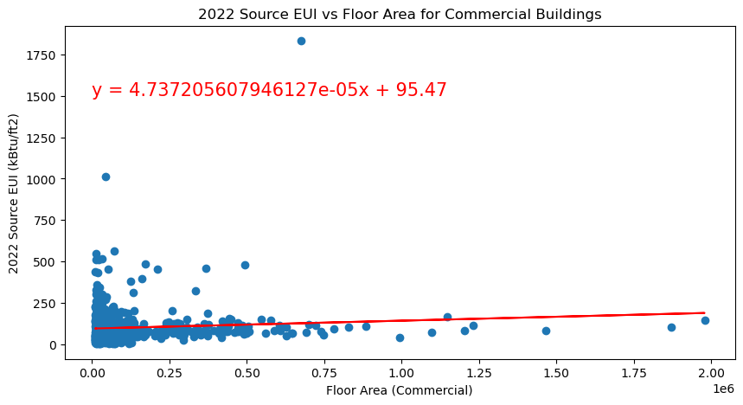
Residential Buildings
Commercial Buildings
Mean correlation of commercial buildings (floor area vs energy use) from 2018 to 2022 is: 0.0805832669848815
Mean p-value of commercial buildings (floor area vs energy use) from 2018 to 2022 is: 0.05119773066264244
Mean correlation of mixed residential buildings (floor area vs energy use) from 2018 to 2022 is: -0.07641699519445266
Mean p-value of mixed residential buildings (floor area vs energy use) from 2018 to 2022 is: 0.5112473898708946

Slide 15
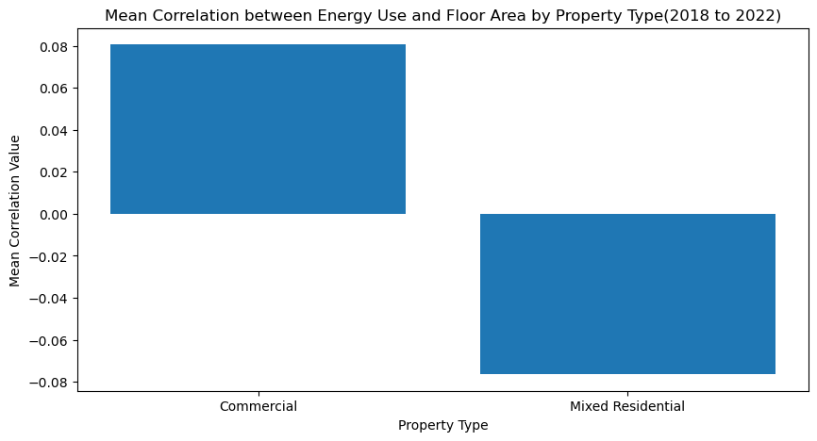
The mean correlation of commercial buildings (floor area vs energy use) from 2018 to 2022 indicates a weak positive correlation between the variables being analyzed. It shows that floor area has some what little impact on energy use in commercial buildings.
On the other hand, A weak negative correlation between energy use and floor area in mixed residential property types suggests that larger floor areas in such buildings are associated with lower energy consumption. This finding can have several potential explanations. It could be due to more efficient building designs, the use of energy-saving technologies, or a higher adoption of sustainable practices in larger mixed residential properties. These buildings might have implemented energy-efficient systems, insulation, or renewable energy sources, resulting in reduced energy consumption.
These findings underscore the significance of implementing energy management strategies and sustainable practices in commercial buildings, while highlighting the potential for energy-efficient designs and technologies in larger mixed residential properties.

Slide 16
Next Steps
The data highlights the vigorous energy consumption and GHG emission by data centers, our next steps would be to find sustainable ways to run data centers.
Consolidate Servers: Turn off any dead servers and optimize your existing servers.
Upgrade Servers: Move to energy efficient servers.
Change To High-Efficiency Power: This removes inefficiencies with multiple AC/DC conversions.
Implement natural cooling and use optimal locations for data centers that have natural cooling effect
Improve Air Management to prevent recirculation of hot air from IT systems
Simple ways of saving energy could be implemented in Labs/Grocery stores/Supermarkets like adding motion detector or light sensor that sense heat in background to analyze movement or presence of people to reduce energy consumption
To reduce GHG emissions from refrigeration systems from supermarkets/Restaurant/Warehouses
Replace refrigerants with low-warming HFCs/new cooling agents/non-HFC substances.
increase the refrigeration efficiency in appliances.
Control leakages of refrigerants from existing appliances.
Ensure recovery, reclaiming /recycling, and destruction of refrigerants at end of life.

Slide 17
Conclusion
REVIEW:
GOAL: Our goal was to identify energy usage and greenhouse gas emission trends, patterns, and relationships for commercial and residential buildings in San Francisco
ACTION ITEMS: Using the insights from the data, we can advise and modify policies for reducing energy use and greenhouse gas emissions
WHAT WE LEARNED: Findings and Final Analysis: It shows that floor area has negligible impact on energy use in commercial buildings. On the other hand, A weak negative correlation between energy use and floor area in mixed residential property types suggests that larger floor areas in such buildings are associated with lower energy consumption. And the properties with highest energy consumption seems to have the highest GHG emission as well.
NEXT STEPS: Identify ways to change policy and equipment to reduce emissions in the cases found like data centers and supermarkets and large GHG emission buildings

Slide 18
References
https://rahi.io/green-data-centers/
https://drawdown.org/solutions/refrigerant-management
https://data.sfgov.org/Energy-and-Environment/Existing-Buildings-Energy-Performance-Ordinance-Re/j2j3-acqj

